Slide 1
Python API: Customization and Visualization
1. TiGL Workshop, September 11 / 12, Cologne
Martin Siggel
German Aerospace Center

Slide 2
Outline
How to modify TiGL-internal shapes
Affine transformations (scaling, translations, rotations …)
Boolean Operations
Visualization with the Qt-based SimpleGui
3D rendering inside a Jupyter notebook
Practical Session

Slide 3
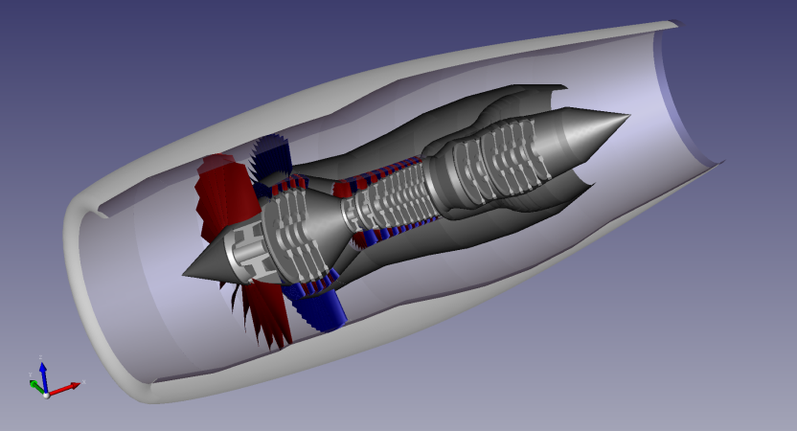
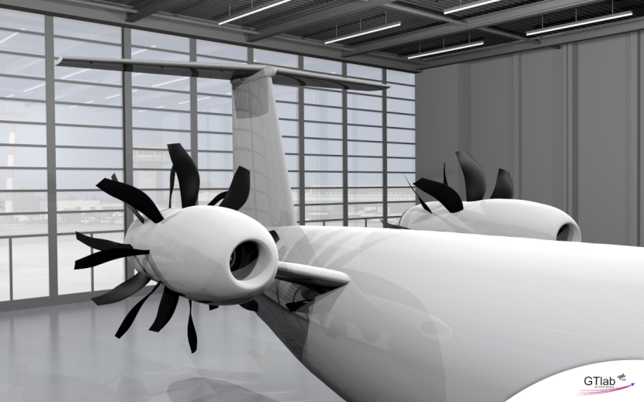
Motivation
Two use cases:
Add new geometric components that are not included in TiGL
Modify/improve existing components
First is straight forward: Just read out CPACS values and model your own geometry
Second: How to modify the shapes? Can something happen?

Slide 4
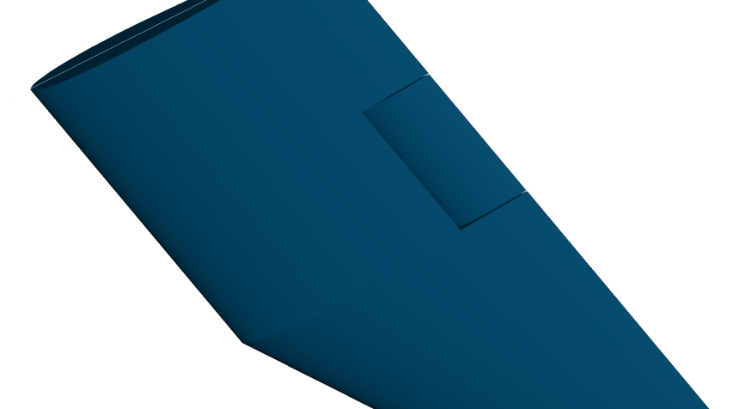
Modification of TiGL shapes
Assume, you want to model wing flaps or wing caps
The wing shape has to be altered
TiGL is not designed to change the internal shapes from outside
TiGL is not designed to change the internal shapes from outside
Still, this is possible!
Each CNamedShape object has a .Set(shape) method:
# create new shape of modify the existing new_shape = ... # now set the changed loft to the wing wing.get_loft().Set(new_shape)

Slide 5
Affine Transformations How to move, resize, rotate shapes
rotate
translate
Shapes can be modified after creation
Basic modification is affine transformation
Use methods from class tigl3.geometry.CTiglTransformation. First build transformation matrix. Order matters!
Transform the shape: transformed_shape = trafo.transform(shape)
scale
Method | Description
.add_translation(x, y, z) | Move the shape
.add_scaling(sx, sy, sz) | Scale the shape along x, y, z axes
.add_rotation_x(angle_degree) | Rotate around the x axis
.add_rotation_y(angle_degree) | Rotate around the y axis
.add_rotation_z(angle_degree) | Rotate around the z axis
.add_mirroring_at_xyplane() | Mirror at the x-y plane
…

Slide 6
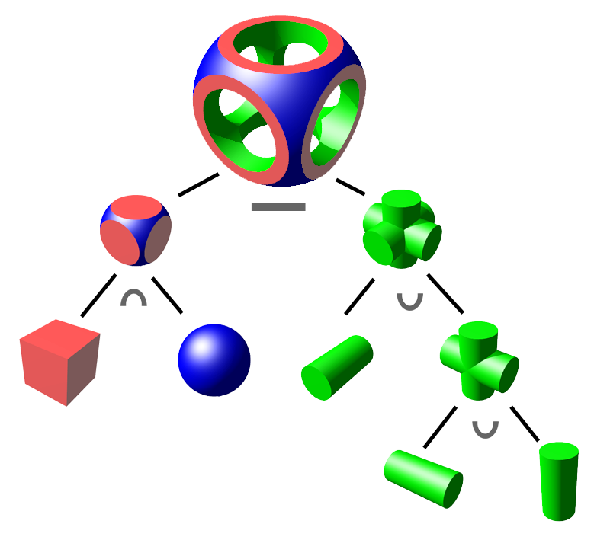
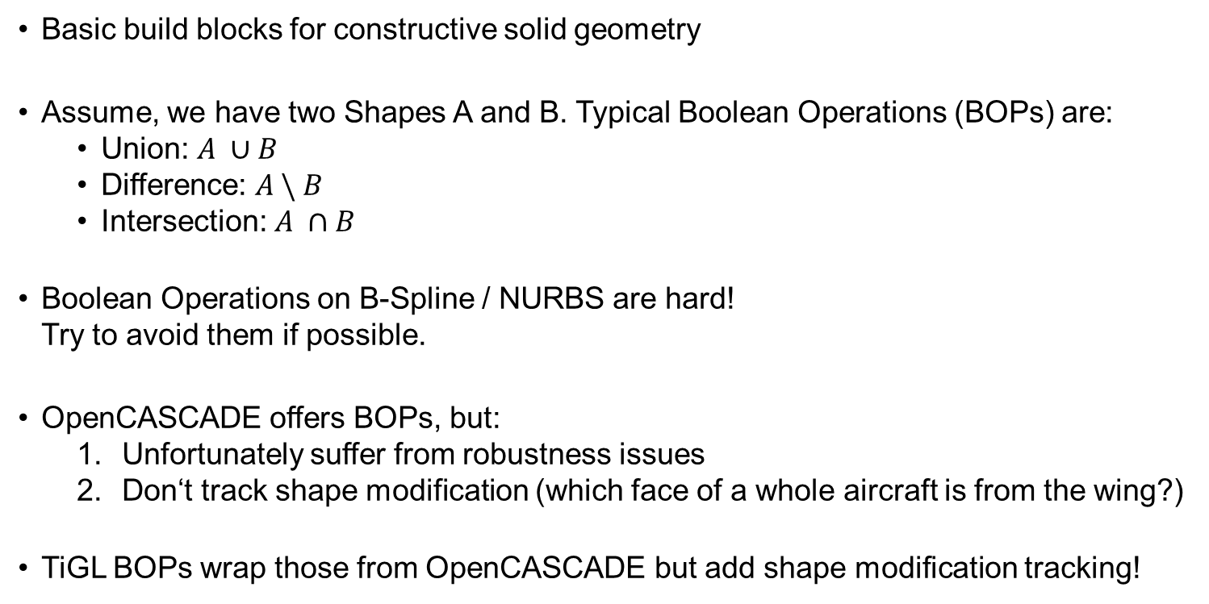
Boolean Operations The tigl3.boolean_ops module
Basic build blocks for constructive solid geometry
Assume, we have two Shapes A and B. Typical Boolean Operations (BOPs) are:
Union: $A ∪B$
Difference: $A \backslash B$
Intersection: $A ∩B$
Boolean Operations on B-Spline / NURBS are hard! Try to avoid them if possible.
OpenCASCADE offers BOPs, but:
Unfortunately suffer from robustness issues
Don‘t track shape modification (which face of a whole aircraft is from the wing?)
TiGL BOPs wrap those from OpenCASCADE but add shape modification tracking!

Slide 7
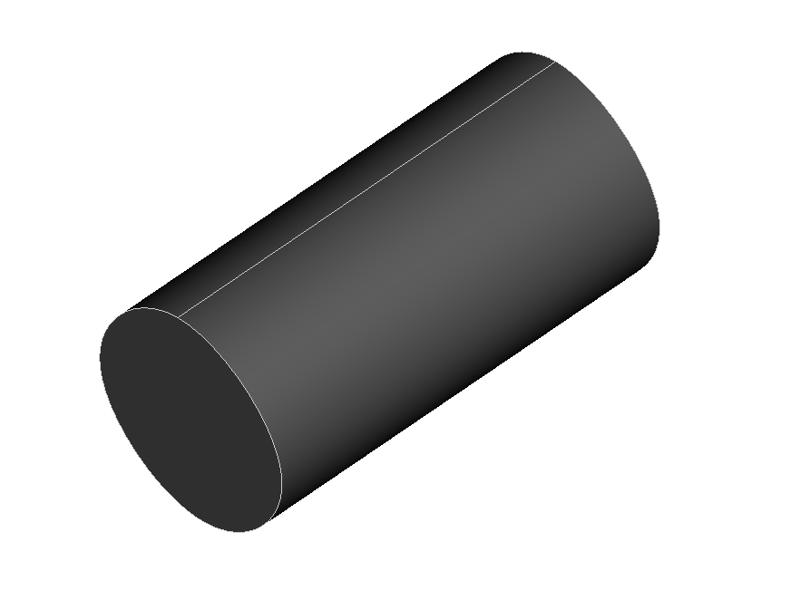
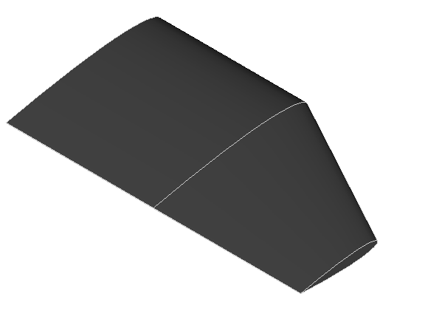
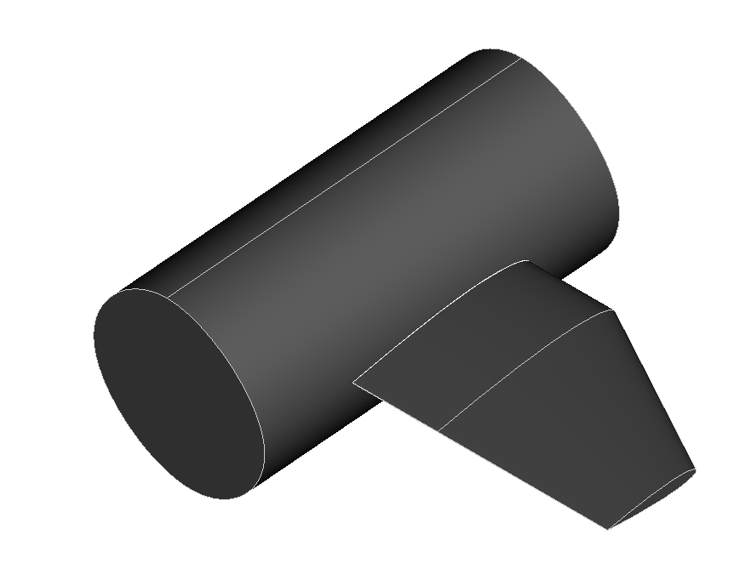


Boolean Operations The tigl3.boolean_ops module
Faces are modified / trimmed by BOP
Difficulty: Figure out, what face of the result is created from which input face
TiGL BOPs do this for you!
Face names are assigned automatically by TiGL
TiGL keeps track of the CSG graph
The following BOP classes from tigl3.boolean_ops can be used:
CFuseShapes: Boolean union of multiple shapes at once
CMergeShapes: Similar to CFuseShapes, but only for shapes that share adajcent faces
CCutShape: Boolean Difference
CGroupShape: No true BOP. Just a group of shapes.
F1
$$+$$
S1
Back
S2
$$=$$
F1
S1
Back
S2

Slide 8
Boolean Operations Example
Lets cut away the internal part of the wing inside the fuselage:
from tigl3.boolean_ops import CCutShape
cutted_wing = CCutShape(wing.get_loft(), fuselage.get_loft()).named_shape()
Now, lets fuse fuselage and both wings
fused_aircraft = CFuseShapes(fuselage.get_loft(),
[wing.get_loft(), wing.get_mirrored_loft()]).named_shape()

Slide 9
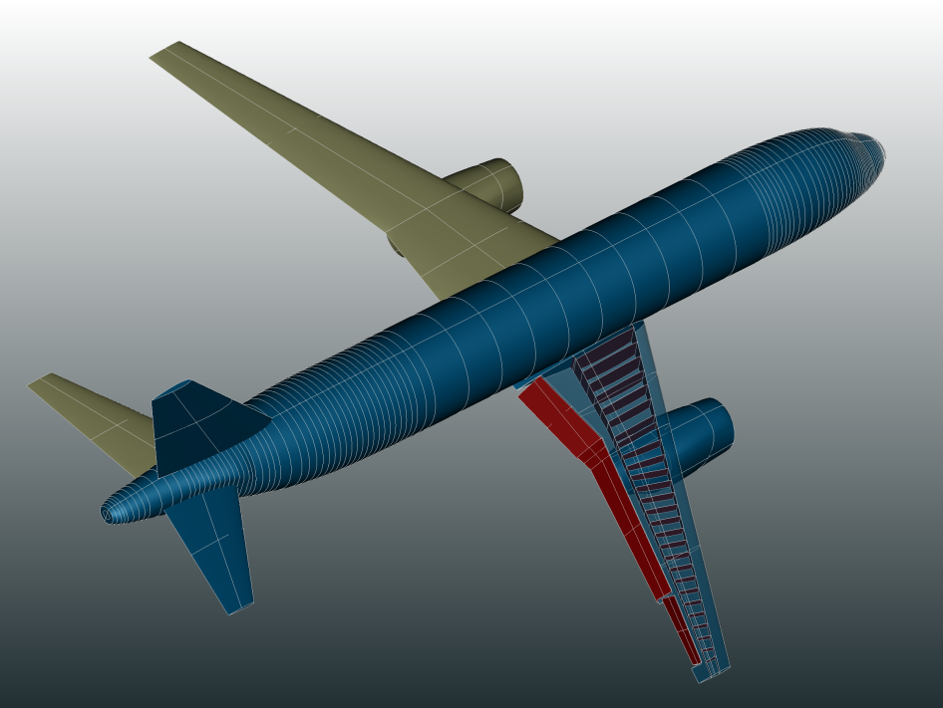
Visualization
Nice images have often more impact than complicated algorithms!
TiGL Viewer was initially developed only for debugging purposes!
Visualization help debugging geometric algorithms or during modelling of complex shapes
Good news:
PythonOCC comes with a 3D viewer, that can be also integrated into own user interfaces!
Also experimental renderer for Jupyter notebook

Slide 10
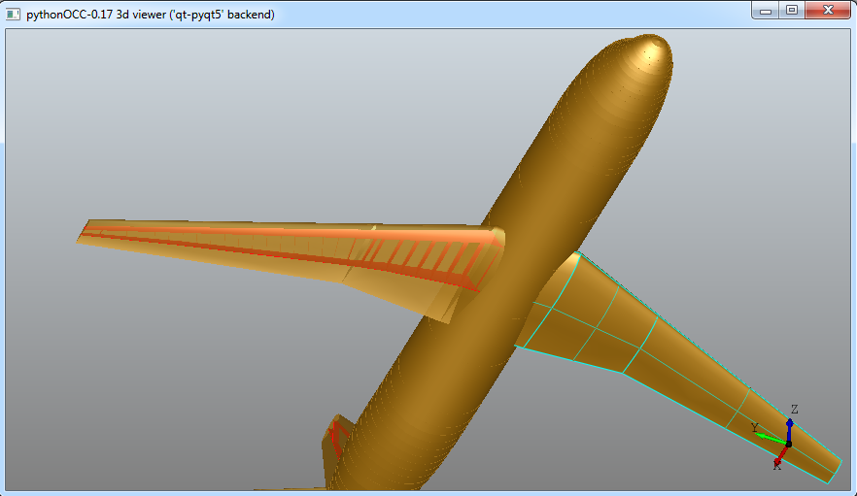
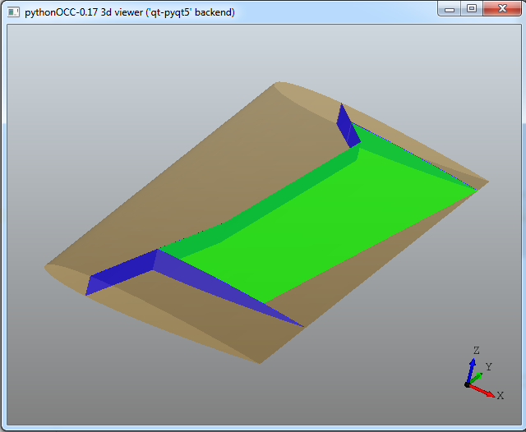
SimpleGui: A Qt-based 3D Viewer
Draw OpenCASCADE shapes (TopoDS_Shape) with only a few lines of code
Can be integrated in larger user interfaces
Possible, to add callbacks to perform actions
Features:
Selection of Colors
Transparency
Set material of shape
Draw Textures
Theoretically, also custom Shader code

Slide 11
SimpleGui: A Qt-based 3D Viewer
To open Viewer window and draw some shapes, we need 3 steps
Create the viewer and store it as viewer from OCC.Display.SimpleGui import init_display viewer, start_display, add_menu, add_function_to_menu = init_display()
Draw a shape. Notice, we must access the TopoDS_Shape from the CNamedShape! viewer.DisplayShape(wing.get_loft().shape(), update=True) If update is True, the viewer will draw the shape immediately.
Start the event loop of the viewer to interact with the visualization: start_display()

Slide 12
SimpleGui: A Qt-based 3D Viewer More control
The DisplayShape() method has several optional parameters to control transparency, color and texture:
DisplayShape(shapes, material=None,texture=None, color=None, transparency=None, update=False)
Color can be
Either a string: e.g. „red“
A color value from the OCC.Quantity package: e.g. OCC.Quantity.Quantity_NOC_GREEN
Material is of type Graphic3d_NameOfMaterial from OCC.Graphic3d:
Graphic3d_NOM_CHROME, Graphic3d_NOM_ALUMINIUM, Graphic3d_NOM_METALIZED, Graphic3d_NOM_SHINY_PLASTIC, Graphic3d_NOM_STONE …
Texture: Why not try to figure it out?

Slide 13
SimpleGui: A Qt-based 3D Viewer More control
The viewer has many methods, which can be grouped as follows:
Mouse interaction
Selection of shapes
Modify eye + look-at position
Functions to add callbacks
Find out, what the viewer can do by using the help
help(OCC.Display.OCCViewer)
Very useful command: Fit displayed objects to screen
viewer.FitAll()

Slide 14
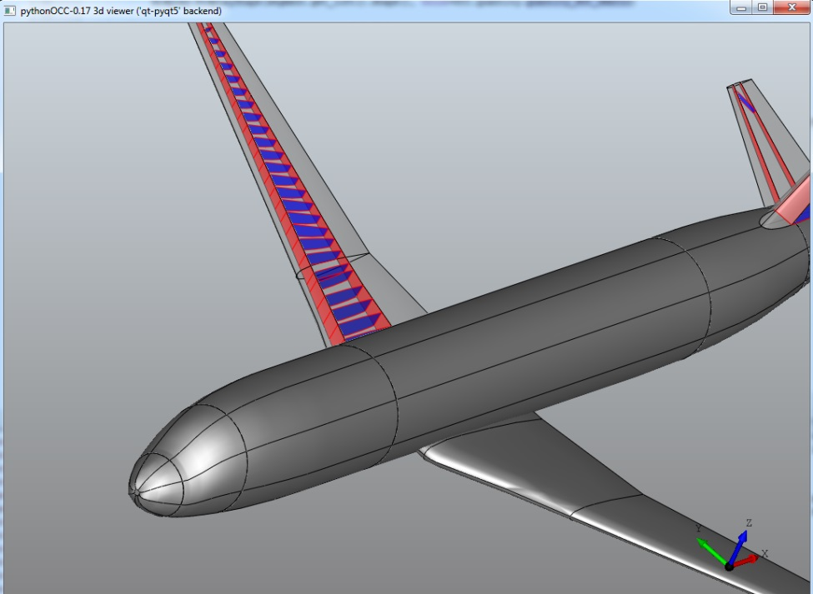
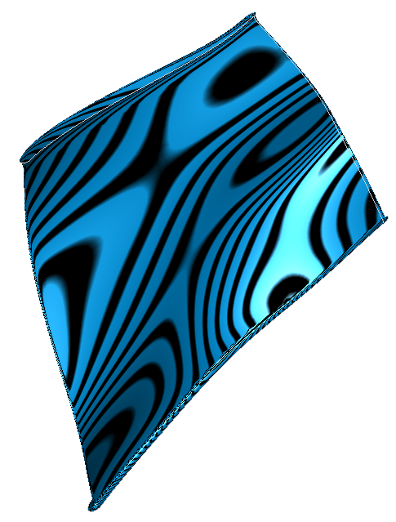
SimpleGui: A Qt-based 3D Viewer Even more control
Much more can be adjusted via the Interactive Context of the viewer.
The context manages the 3D scene and all graphic attributes (line colors, shading colors, custom shader code …)
Access interactive context: viewer.Context
Look into the OpenCASCADE documentation for much more control and customization:
https://www.opencascade.com/doc/occt-7.3.0/overview/html/occt_user_guides__visualization.html

Slide 15
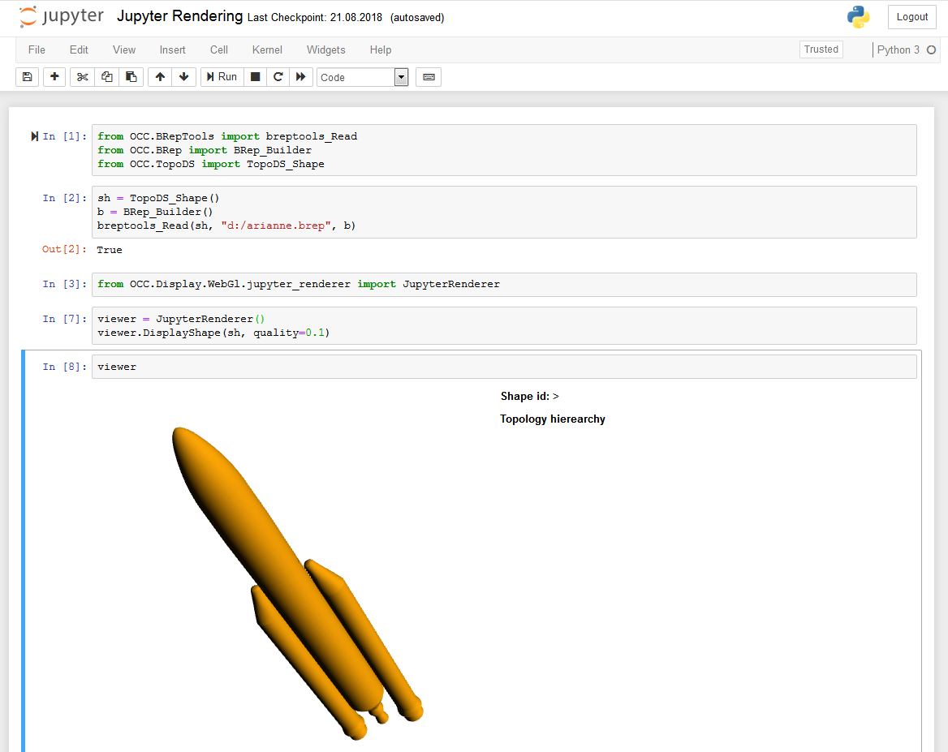
Visualization inside Jupyter Notebook

Slide 16
Visualization inside Jupyter Notebook
Jupyter gives you a nice interactive python shell inside your browser
Using WebGL and Javascript, it is possible to render 3D geometries on web pages
The Jupyter renderer is
An experimental feature of pythonOCC
Back-ported into our conda packages from the latest source
Not as mature and has less features than the other viewer!
Still, it is fun…

Slide 17
Visualization inside Jupyter Notebook Howto
Again, we need 3 steps
Create the viewer from OCC.Display.WebGl.jupyter_renderer import JupyterRenderer viewer = JupyterRenderer()
Add shapes to the viewer viewer.DisplayShape(wing.get_loft().shape(), quality=0.1)
Render the viewer window viewer

Slide 18
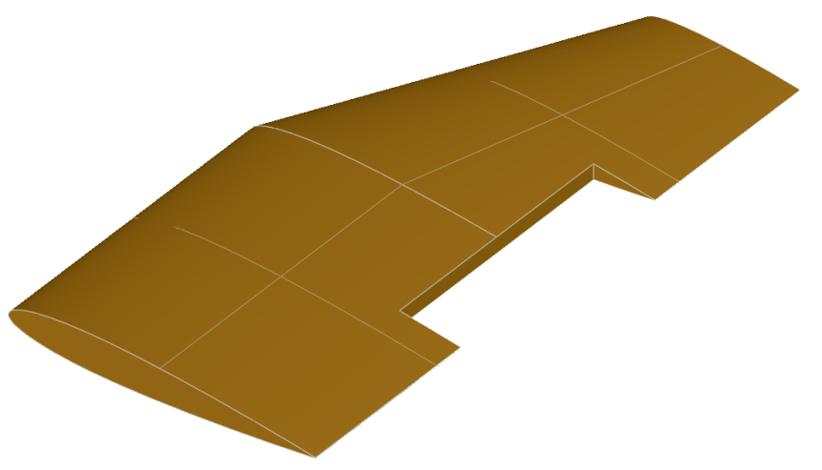
Practical Session: Customization Visualization
Now it‘s your turn
Goal: Model, export and visualize a wing flap cutout: You can do this, by subtracting a box from the wing.
Possible Tasks:
Open exercise 2 from course material inside a Jupyter notebook
Access the first wing
Create a box
Move the box to the desired position
Use TiGL’s Boolean operations to cut out the box
Apply the result to the wing component
Export the fused airplane to STEP format with: tigl_handle.exportConfiguration
Visualize the result with the SimpleGui
Try to change color etc
Visualize the result directly in the Notebook

Slide 19
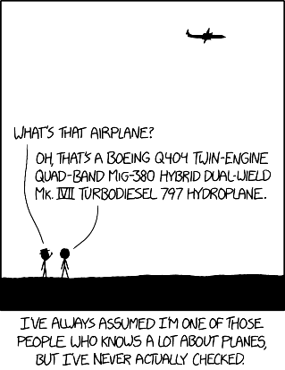
Any Questions?

